Slide 1


Introduction to Leaf Disease Detection
Leaf disease detection using deep learning involves the identification and classification of plant diseases through advanced technology. It aims to provide a method for farmers and botanists to promptly identify and address plant health issues.

Slide 2

Agenda
1
Identifying Project Objectives
Understanding the goals of leaf disease detection.
2
Data Collection and Preprocessing
Gathering and preparing the data for model training.
3
Model Training and Validation
Training the deep learning model and validating its accuracy.

Slide 3

Project Statement
1
Problem Statement
2
Scope and Impact
Identifying the need for efficient leaf disease detection in agriculture.
Discussing the potential impact and scope of the project.
3
Technical Challenges
Exploring the technological challenges associated with the project.

Slide 4
Project Overview
Data Collection
Model Development
Deployment Strategy
Gathering leaf images from various sources.
Constructing a deep learning model for disease classification.
Planning the deployment of the solution in real-world scenarios.
Ensuring a diverse dataset for accurate model training.
Implementing advanced algorithms and frameworks.
Ensuring ease of use and scalability.

Slide 5



Who are the End Users?
Farmers
Botanists
Agricultural Researchers
Utilizing the technology for crop health monitoring.
Researching and analyzing plant diseases more effectively.
Contributing to advancements in agricultural science.

Slide 6



Your Solution and its Value Proposition
Accuracy
Efficiency
Scalability
Providing precise disease identification and classification.
Offering a rapid and automated solution for disease detection.
Adapting to varying scales of agricultural operations.

Slide 7

The Wow in Your Solution
Advanced Technology
Real-time Analysis
Utilizing cutting-edge deep learning algorithms.
Providing instant feedback and diagnosis.
User-Friendly Interface
Ensuring ease of use for non-technical users.

Slide 8
Modeling
Deep Learning Algorithm
Utilizing CNN for image analysis.
Data Augmentation
Enhancing model robustness and generalization.
Validation Metrics
Measuring precision, recall, and F1 score.

Slide 9
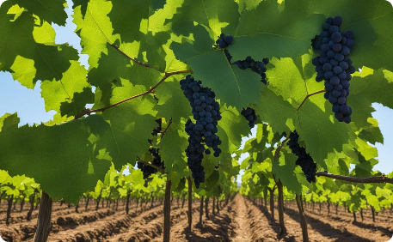
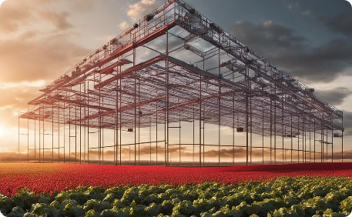
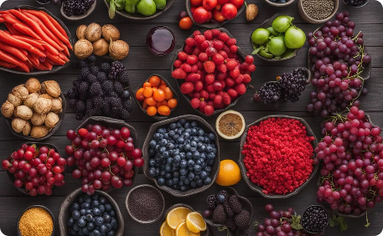
Conclusion
Positive Impact
Innovation in Agriculture
Collaborative Growth
Healthy crops leading to better yields and sustainable agriculture.
Empowering agricultural communities through collaborative efforts.
Elevating agricultural practices through technological advancement.

